Slide 1



Deep Riemannian Neural Architectures for Domain Adaptation in Burst cVEP-based Brain Computer Interface
Velut Sébastien^{1,2}, Chevallier Sylvain², Corsi Marie-Constance³, Dehais Frédéric¹
1- Fédération ENAC ISAE-SUPAERO ONERA, Université de Toulouse, 10 avenue Edouard Belin, 31400, Toulouse - France
2- A&O - LISN - Université Paris-Saclay 1 rue René Thom, 91190 Gif-sur-Yvette - France
3- Sorbonne Université, Institut du Cerveau - Paris Brain Institute -ICM, CNRS, Inria, Inserm, AP-HP, Hôpital de la Pitié Salpetriere, F-75013, Paris, France

Slide 2
Introduction

Slide 3
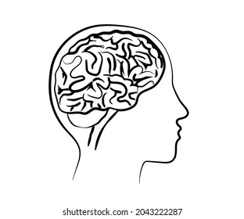
What is a Brain computer Interface (BCI) ?
Signal Processing
Preprocessing
Features extraction
Classification
Signal Acquisition
Application interface
Applications :
Spelling device
Wheelchairs
Video games
Mental state monitor

Slide 4
Variabilities sources
Anatomy:
Grey matter quantity
Human: way of life, education
Physiological : fatigue, concentration, stress, circadian rythm
Environmental condition:
Luminosity, displacement of electrodes, noise
S. Saha and M. Baumert. Intra- and inter-subject variability in EEG-based sensorimotor brain computer interface: A review. Frontiers in Human Neuroscience, page 8, 2020.

Slide 5
Transfer Learning
Leave one out of all (LOO)
Classifier adaptation
Features adaptation
Latent tranfer learning
Optimal transport
S. Khazem et al. Minimizing subject- dependent calibration for bci with riemannian transfer learning. In IEEE/EMBS Conference on Neural Engineering (NER), pages 523–526, 2021. F. Fahimi et al. Inter-subject transfer learning with end-to-end deep convolutional neural network for EEG-based BCI. Journal of Neural Engineering, page 13, 2018. B. Aristimunha et al. Evaluating the structure of cognitive task with transfer learning. In NeurIPS workshop AI4Science, page 19, 2023.

Slide 6
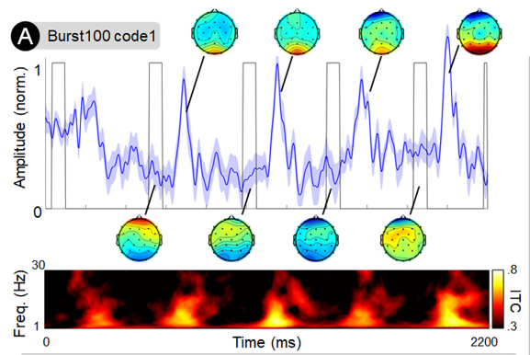
Paradimg: Burst-CVEP
Few flashes per second (3 per second aperiodically)
Allows bitwise decoding
Strong response
High SNR
Martinez-Cagigal et al. Brain-computer interfaces based on code-modulated visual evoked potentials (c- VEP): a literature review. Journal of Neural Engineering, 2021. K. Cabrera Castilloset al. Burst c-VEP based BCI: Opti- mizing stimulus design for enhanced classification with minimal calibration data and improved user experience. NeuroImage 2023.

Slide 7
Experiment

Slide 8
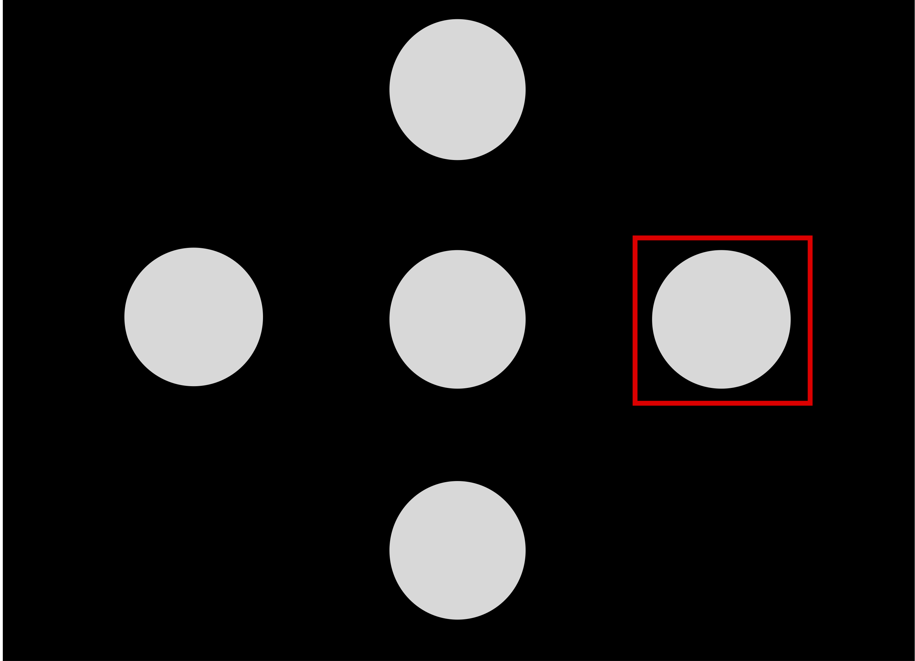
Datasets
1
Dataset:
Burst-CVEP and CVEP based EEG
12 participants
1 session each
2 modes : CVEP et Burst-CVEP
15 runs of 4 different 2,2s stimuli each
2
4
3
K. Cabrera Castillos, et al. Burst c-VEP based BCI: Opti- mizing stimulus design for enhanced classification with minimal calibration data and improved user experience. NeuroImage, page 11, 2023.

Slide 9



Methods
Comparison between CNN and two types of SPDNet
Comparison between Domain Generalization, Domain Adaptation and Single Subject
Data are normalized, spatialy and temporaly filtered and spatialy recentered
Framewise decoding to reconstruct the code and perform template matching
Use of MOABB for stastitical analysis
Offline analysis
Domain Generalization
Training/val data:
11 subjects
Testing data:
12th subject
Domain Adaptation
Training/val data:
11 subjects et a part of 12th subject
Testing data:
Rest of data from 12th subject
Single Subject
Training/val data:
A part of data from subject i
Testing data:
Rest of data from subject i

Slide 10
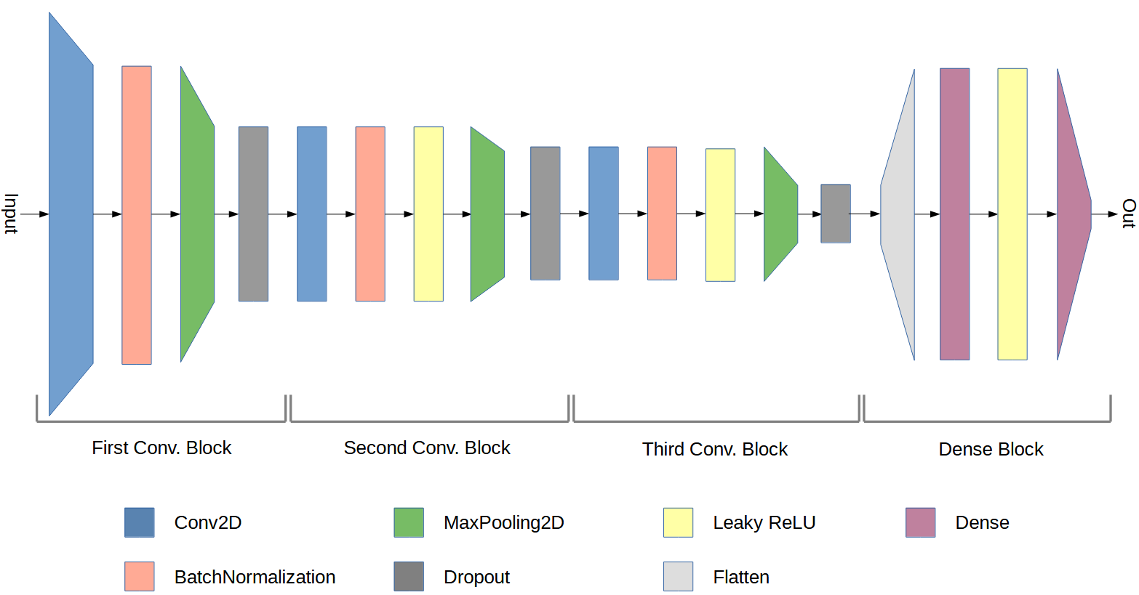
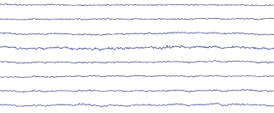

CNN
Convolutional Neural Network (CNN)
K. Cabrera Castillos, et al. Burst c-VEP based BCI: Opti- mizing stimulus design for enhanced classification with minimal calibration data and improved user experience. NeuroImage, page 11, 2023.

Slide 11
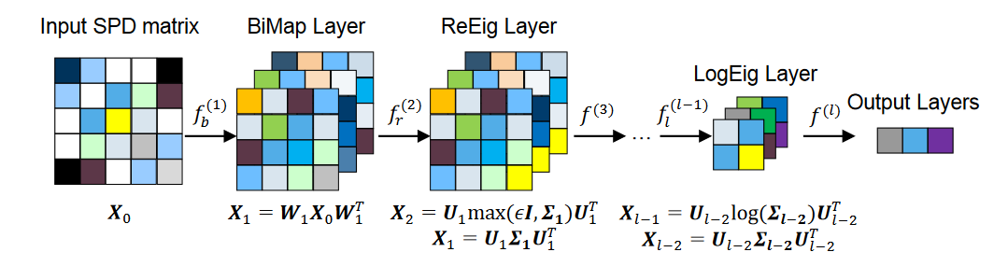
SPDNet
Covariance
transformation
Z. Huang and L. Van Gool. A riemannian network for SPD matrix learning. In AAAI, page 9, 2017
R. Kobler et al. SPD domain-specific batch normalization to crack interpretable unsupervised domain adaptation in EEG. In NeurIPS, 2022.

Slide 12
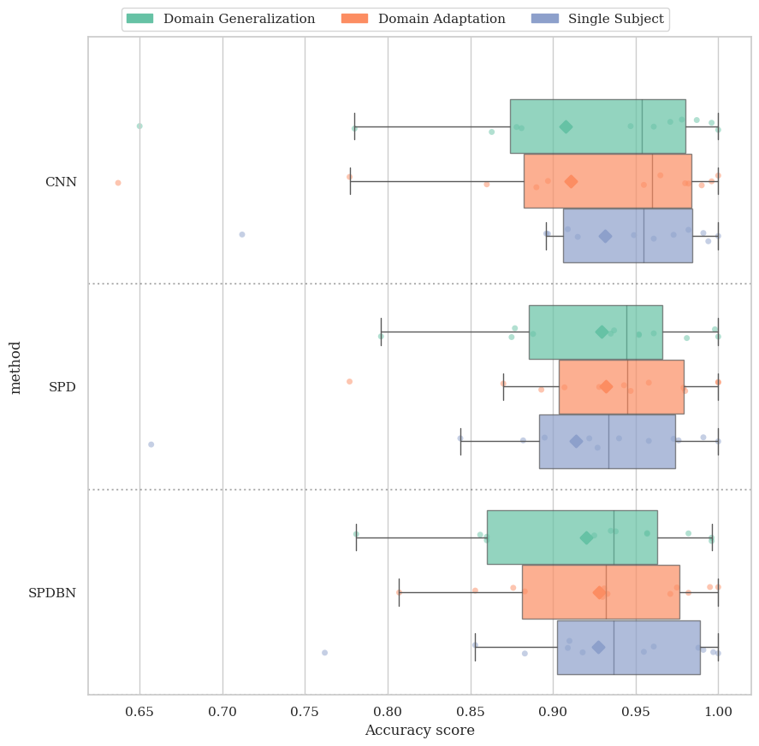
Resultats
DA setting performs higher than DG setting
All three models show comparable performance without significant differences (except in SS setting)
~ 93% accuracy
Riemannian DeepLearning algorithms seems more consistent than CNN
SPDBNNet is slower than SPDNet and CNN (training time: 1400s vs 130s)

Slide 13
Conclusion

Slide 14
Future direction
Find new features to improve transferability
Train on similar subjects
Test on data of an on-going experiment to check inter-session variabilities

Slide 15
Thank you for listening !

